Slide 1

Browser Object Model

Slide 2
Window Object
The window object is supported by all browsers. It represents the browser's window.
All global JavaScript objects, functions, and variables automatically become members of the window object.
Global variables are properties of the window object.
Global functions are methods of the window object.
Even the document object (of the HTML DOM) is a property of the window object:
window.document.getElementById("header");
is the same as:
document.getElementById("header");

Slide 3
open()
The open() method creates a new secondary browser window, similar to choosing New Window from the File menu.
General syntax:
window.open(URL, name,"attribute1=value,attribute2=value", replace);
URL to be fetched and loaded in the new window.
If URL is an empty string, then a new blank, empty window (URL about:blank) is created with the default toolbars of the main window.
name is the name you wish to give to the window.
list of attributes, set by using “yes”, “no”, or a numeric value on the right side of the equal sign. Attributes are split with a comma.
replace specifies whether the URL creates a new entry or replaces the current entry in the history list.

Slide 4
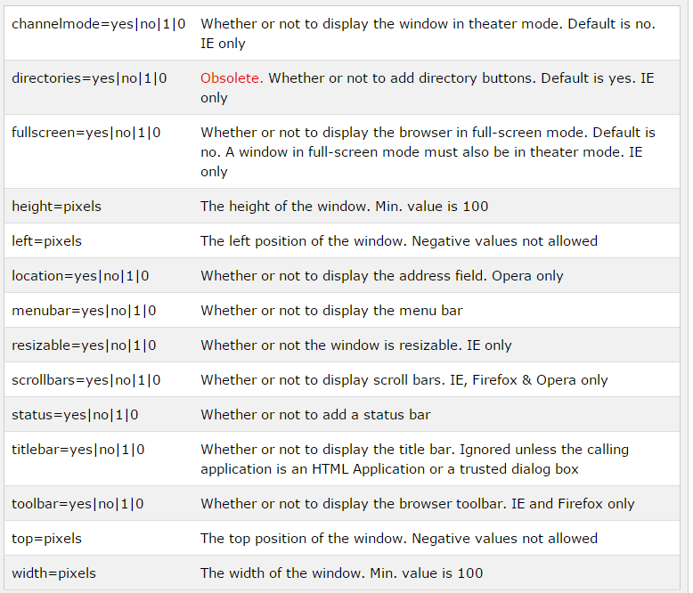
open()

Slide 5
open()
For example, if you wanted to open an about:blank page in a new window with 300×200 pixels and no menu bar, you could use the following code:
window.open("", "","width=300, height=200,menubar=no");
Notes:
Ex1

Slide 6
More Methods
moveBy(x,y) is used to move a window to a new location on the screen, by the number of pixels given as parameters.
moveTo(x,y) is used to move a window to a specific destination on the screen based on the parameters given in the method call.
resizeBy(x,y) is used to resize a window by the number of pixels given in the parameters sent in the method call. To make the window larger, use positive numbers. To make it smaller, use negative numbers.
resizeTo(x,y) is used to resize a window to a specific dimension in pixels based on the parameters sent in the method call.
scrollBy(x,y) is used to scroll a window by the number of pixels given in the parameters sent in the method call.
scrollTo(x,y) is used to scroll a window to a specific destination in pixels based on the parameters sent in the method call.
window.close() – is used to close the current window.

Slide 7
Window innerWidth and innerHeight
The width and height of the area of the window in view, not including scroll bars, menu bars, toolbars, or other browser features. Values in pixels.
Example:
var width = window.innerWidth;
var height= window.innerHeight;
For better compatibility with older browsers (e.g., IE8) use this:
width = window.innerWidth || document.documentElement.clientWidth || document.body.clientWidth;
height = window.innerHeight || document.documentElement.clientHeight || document.body.clientHeight;

Slide 8
Window Screen
Related to resolution of the screen, in pixels.
The window.screen object can be written without the window prefix:
screen.width
screen.height
screen.availWidth
//the width of the visitor's screen, in pixels, minus interface features like the Windows Taskbar.
screen.availHeight
screen.colorDepth
// the number of bits used to display one colour
screen.pixelDepth
// for modern computers, Color Depth and Pixel Depth are equal

Slide 9
Window Location
The window.location object can be written without the window prefix:
location.href
// returns the href (URL) of the current page
location.hostname
// returns the domain name of the web host, e.g. www.dit.ie
location.pathname
// returns the path and filename, e.g. /newsandevents/news/
location.protocol returns the web protocol used
// http: or https:
location.assign
// loads a new document, “redirect”
location.replace
// loads a new document like location.assign, except that the page will not be retained in the document history,, and so users will not be able to use the Back button
Notes:
http://www.dit.ie/newsandevents/news/
The windows.assign() method loads a new document (i.e., “location.assign(url)”). It’s pretty much the same as “location.href = url”.
You’ll sometimes see URL assignments to both location.href and location (i.e., location = url, location.href = url).

Slide 10
Window History
The window.history object can be written without the window prefix.
To protect the privacy of the users, there are limitations to how JavaScript can access this object.
Some methods:
history.back() - same as clicking back in the browser
history.forward() - same as clicking forward in the browser
history.go(-2) – same and going back two pages, i.e., calling back() twice.
history.go(2) – same and going forward two pages, i.e., calling forward() twice.
history.length – outputs the number of pages in the history stack.
HTML5 introduced the pushState() and replaceState() methods, which allow you to add and modify history entries respectively.
Notes:
Limitations e.g., only access pages that the user has visited and record of which is available within the browser stack
You need to ensure browser compatibility before using.

Slide 11
Window Navigator
The window.navigator object contains information about the visitor's browser.
It can be written without the window prefix.
Some examples:
navigator.language
// e.g. en-GB
navigator.platform
// returns the operating system, e. g. Win32
navigator.javaEnabled()
// returns true if Java is enabled
navigator.cookieEnabled
// returns true if cookies are enabled

Slide 12
Window Popups
Alert Box
An alert box is often used if you want to make sure information comes through to the user.
When an alert box pops up, the user will have to click "OK" to proceed.
window.alert("sometext");
Confirm Box
A confirm box is often used if you want the user to verify or accept something.
When a confirm box pops up, the user will have to click either "OK" or "Cancel" to proceed.
If the user clicks "OK", the box returns true. If the user clicks "Cancel", the box returns false.
window.confirm("sometext");

Slide 13
Window Popups
Prompt Box
A prompt box is often used if you want the user to input a value before entering a page.
When a prompt box pops up, the user will have to click either "OK" or "Cancel" to proceed after entering an input value.
If the user clicks "OK" the box returns the input value. If the user clicks "Cancel" the box returns null.
window.prompt("sometext","defaultText");
All popups can be written without the window prefix
alert(), confirm(), prompt()
To display line breaks inside a popup box, use \n
Notes:
\n = line feed

Slide 14
Timing Events
The window object allows execution of code at specified time intervals (timing events):
setTimeout(function, milliseconds)
// executes a function, after waiting a specified number of milliseconds
setInterval(function, milliseconds)
// same as setTimeout(), but repeats the execution of the function continuously
clearTimeout(var)
// stops the execution of the function specified in setTimeout(), saved into a //variable
clearInterval(var)
// stops the executions of the function specified in the setInterval() method

Slide 15
setTimeout and clearTimeout
<button onclick="myFunction()">Try it</button>
<button onclick="stopMyFunction()">Stop the alert</button>
<script>
var myVar;
function myFunction() {
myVar = setTimeout(function(){ alert("Am I bothering you yet?"); }, 3000);
}
function stopMyFunction() {
clearTimeout(myVar);
}
</script>
Notes:
Ex 2
Function set to call alert after waiting 3 seconds

Slide 16
setInterval()
For example you could use this method to pop up an alert every 2 seconds (2,000 milliseconds) once the page is viewed:
<html>
<head>
</head>
<body>
<script>
function annoy_alert() {
alert("Am I bothering you yet?");
}
setInterval(annoy_alert, 2000);
// setInterval(“annoy_alert()”, 2000);
</script>
</body>
</html>
Notes:
Ex 3
Notice the syntax!

Slide 17
Window print()
When this method is called, it will open the browser’s Print Dialog Box, so that the user can set the printer settings to print the document.
<form>
<input type="button" value="Click to Print Page"
onclick="window.print();">
</form>
Tip
Make the page print-friendly.

